Slide 1

DO LLMS UNDERSTAND WHAT THEY “KNOW”:
Analyzing if LLMs can solve Simple
Analogies devoid of the relations
Presenter : Gaurav Malakar
Supervisor: Prof. Pawan Goyal
Mentor: Mr. Abhilash Nandy

Slide 2
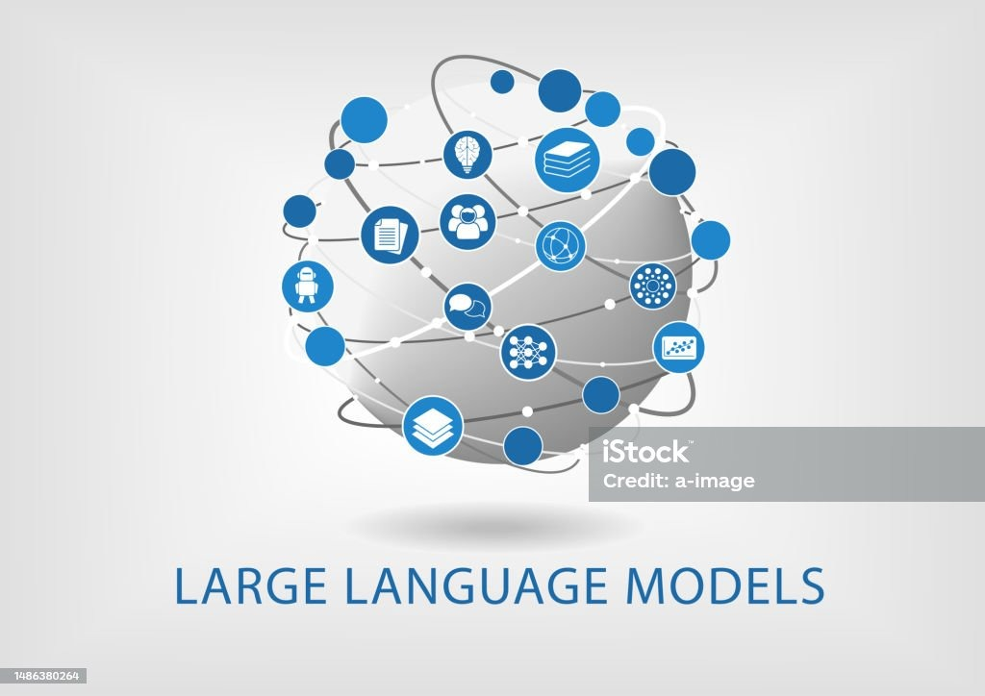
1
The New Stars: LLMs
"In the world of tech, LLMs are making waves."
What are LLMs? They're big computer modelsthat know a lot of words and ideas.
They can do many tasks, but do they really "understand" what they know?
“Do these models genuinely grasp the content they’ve been trained on, or are they merely echoing patterns?”

Slide 3
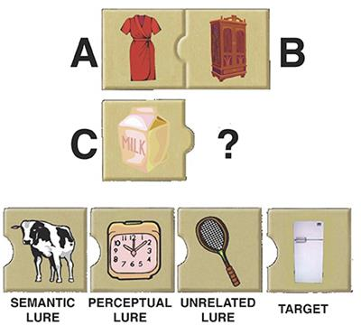
Thinking in Parallels: Analogical Reasoning
2
It's like when we think, "This new thing is kind of like that old thing I know."
Humans use it to solve problems by comparing them to things they already understand.
When humans encounter unfamiliar situations, they often draw parallels with known scenarios to derive solutions.
Big Question:
Can LLM﻿s think this way too?

Slide 4
Literature Review
3
Emergent Analogical Reasoning in Large Language Models:
Comparative analysis between human reasoning and GPT-3.
Highlights LLMs' robust capacity for abstract pattern induction.
An Explanation of In-context Learning as Implicit Bayesian Inference:
Explores GPT-3's ability for in-context learning.
Introduces a synthetic dataset, GINC, showcasing in-context learning.
Large Language Models As Analogical Reasoners:
Introduces the concept of analogical prompting.
Guides LLMs to self-generate relevant exemplars or knowledge in context.
Demonstrates adaptability across various reasoning tasks.

Slide 5
4
WHAT DID WE DO?
While many have explored the analogical capabilities of LLMs, our approach offers a fresh lens, diving deeper into their reasoning abilities in a way not done before.
Query Format Used:
A:B::C:X
A, B, C are known personalities and A, B are closely related
LLMs are asked to deduce X based on A and B's relationship.

Slide 6

5
BUT WHATS NEW ?
Pre-Awareness
The Shift: Instead of just throwing tests at LLMs, we first ensured they were aware od the relationship between A-B and C-X.
Beyond Memory: It's not about what LLMs can recall. It's about how they think and reason with what they already "know".
IIT KHARAGPUR | 2023

Slide 7
6
DATASET
Sources
The dataset was manually curated from the mentioned sources. The objective behind this particular choice was to formulate the analofies based on figures from diverse backgrounds and time periods, hence making the task more challenging and novel.
Wikipedia: "List of Indian monarchs"
Totally History: “Famous Philosophers”
Preprocessing
Structure
Query LLM: "Who is the son of <name>?".
Cross-check with 'Children' data.
Discard mismatches.
Purpose: Ensure genuine LLM knowledge.
Indian Rulers: 'Name' & 'Children'.
Philosophers: 'Name' & 'Children'.

Slide 8
7
A GLIMPSE OF THE DATA
Name | Children
Confucius | Kong Li
Aristotle | Nicomachus,Pythias
William James | Henry James,Alexander James,Margaret James
Bertrand Russell | John Russell,Conrad Russell,Katharine Tait
Name | Children
Akbar | Jahangir
Raja Raja I | Rajendra Chola I
Chandragupta Maurya | Bindusara
Ashoka | Mahinda
IIT KHARAGPUR | 2023

Slide 9
8
MEET THE LLMs
Llama-2-7b-chat-hf
IIT KHARAGPUR | 2023
GPT-3.5
Llama-2-13b-chat-hf
vicuna-13b-v1.3

Slide 10
9
﻿RESULT
Accuracies:
GPT-3.5: 15%
Llama-2-7b-chat-hf: 10%
Llama-2-13b-chat-hf: 9%
vicuna-13b-v1.3: 6%
These underwhelming outcomes emphasize that analogical reasoning remains a complex challenge, even for the likes of advanced LLMs

Slide 11
10
ANALYSIS
To get a deeper understanding of the reasons behind GPT-3.5 poor performance in this task a thorough analysis was done:-
1
Frequency Analysis: The frequency of occurrence of the correct answer was compared against the frequency of the answer provided by GPT-3.5. on Wikipedia Page of Parent
Larana University | 2024
2
Qualitative Analysis: GPT-3.5 was prompted to justify its answers. It sometimes found unexpected relationships. Example: Predicted “Successor” instead of “Son”
3
Preprocessing Limitations: There were instances where GPT-3.5 claimed not to know the relationship between terms, even though the data preprocessing step ensured that the model was familiar with these relation-ships.

Slide 12
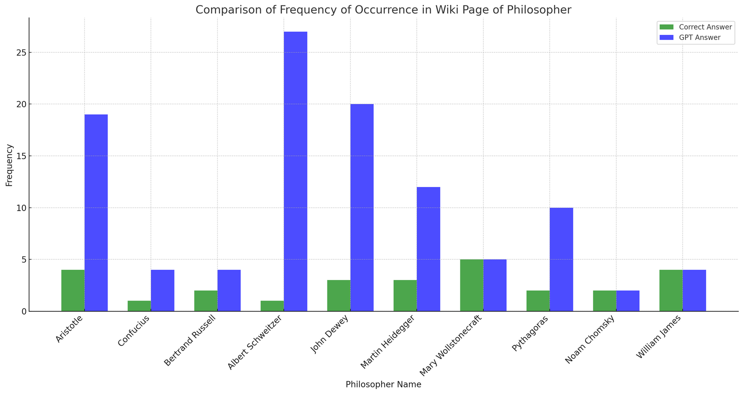
11
WIKI-COUNT CHART

Slide 13
12
FUTURE PLAN
Error Analysis
Dive deeper into specific errors made by LLMs. Explore Embeddings
In-context Learning
IIT KHARAGPUR | 2023
Explore insights from "An Explanation of In-context Learning as Implicit Bayesian Inference" (Xie et al., 2021) and other papers on prompting techniques for achieving better performance in analogical tasks
Goal
Develop methods to address LLMs' shortcomings.
Harness LLMs' potential for better analogical reasoning.

Slide 14
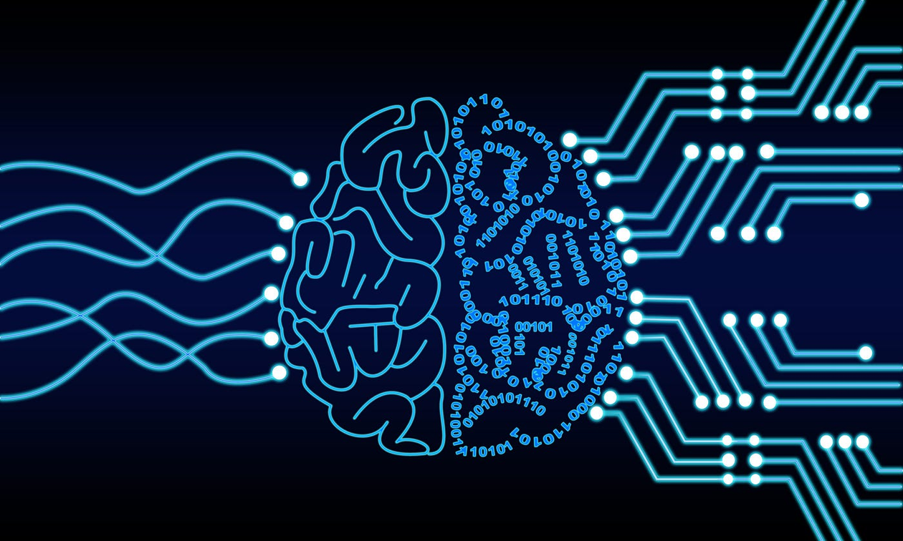
13
FINAL THOUGHTS
Journey: Machine learning has always aimed to make machines think like us.
Traditional Focus: Improving machines from the inside (more storage, better methods).
A New Approach: Train machines like humans, without changing their insides.
Our Research: Embraces this new training method, especially with LLMs.
Belief: Simple steps today can lead to big breakthroughs tomorrow.

Slide 15
14
REFERENCES
An, S., Ma, Z., et al. (2023). Learning from mistakes makes LLM better reasoner. arXiv:2310.20689.
Webb, T., Holyoak, K. J., & Lu, H. (2023). Emergent analogical reasoning in large language models. Nature Human Behaviour, 7(9), 1526–1541.
Xie, S. M., Raghunathan, A., Liang, P., & Ma, T. (2021). An explanation of in-context learning as implicit bayesian inference. International Conference on Learning Representations.
Yasunaga, M., Chen, X., et al. (2023). Large language models as analogical reasoners. arXiv preprint arXiv:2310.01714.

Slide 16
IIT KHARAGPUR | 2023
THANK YOU
Presented By : Gaurav Malakar

